Slide 1
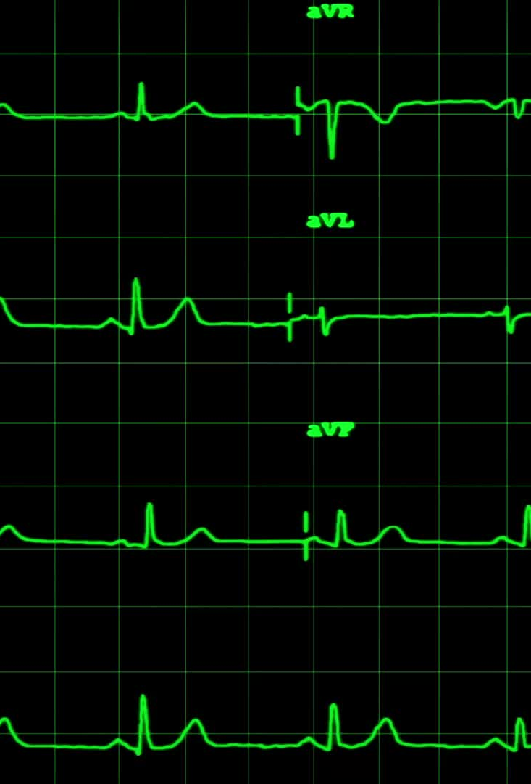
Patient Similarity using Relational Graph Convolutional Networks
High Risk Project – Spring 2025
Julian E Gomez
Razal Minhas
Sonal Pardeshi

Slide 2
Deliverables
Final Report
Presentation
Video
GitHub repo

Slide 3
Agenda
Introduction - EHR Growth and Challenges
Project Overview
Methodology
Data Preparation
Patient Similarity
Graph Creation
Relational Convolutional Graph Network
Results
Future Directions

Slide 4
Introduction - EHR Growth and Challenges
Healthcare generates ~30% of world's data volume [1]
Yet 97% of the data is unused [1]
Challenges in analyzing data:
Data structures and integration as evidenced by the MIMIC initiative
Access and data preprocessing needs
Privacy
Data biases

Slide 5



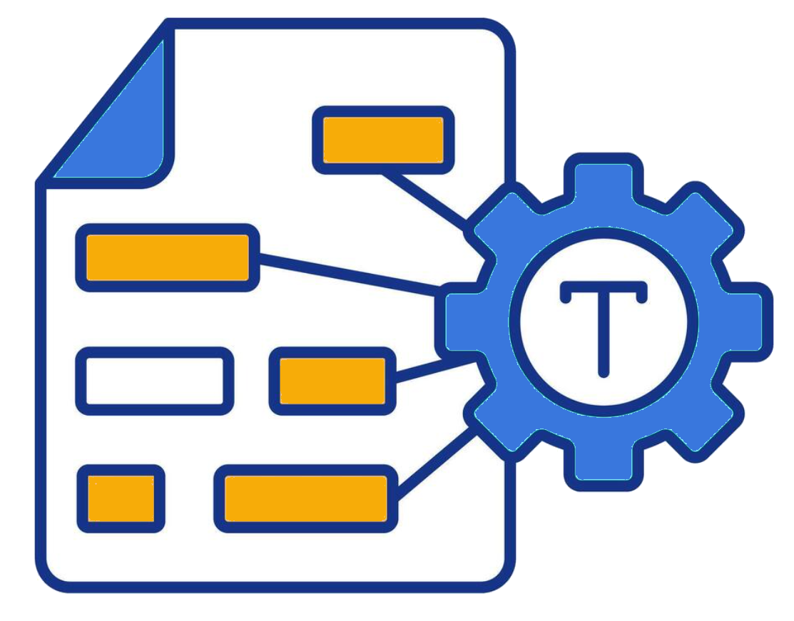

Project Overview
Objective: Learn patient embeddings through contrastive learning to find similar patients
Method: Heterogeneous graph representing patients, diagnoses, and procedures as nodes
Approach: Apply Relational Graph Convolutional Networks (R-GCN)
Benefits: Help physicians find similar patient profiles to improve treatment decisions
Data Source: MIMIC-III database (Medical Information Mart for Intensive Care)
Patient Graph with Diagnosis, etc.
train
MIMIC
test
Vector Embeddings
Patient Similarity Pairings
Relational Graph Convolutional Network
RAG System

Slide 6
Data Preparation
MIMIC-III Database:
De-identified health data for ~46.5K ICU patients
651K diagnoses and 240K procedures
Downsampled to 25%
Features:
Patient: Demographics (gender, age)
Diagnoses: ICD-9 codes and descriptions
Procedures: Procedure codes and descriptions

Slide 7
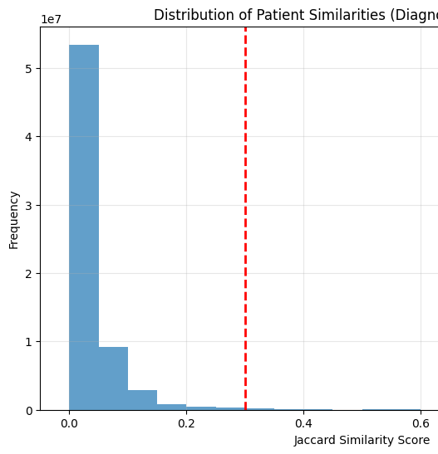
Patient Similarity
Jaccard Similarity used to identify similar patients:
J(A,B) = |A ∩ B| / |A ∪ B|
A and B are sets of diagnoses and procedures for two patients
Similarity Calculation:
Analyzed ~67.6M patient pairs using sparse matrices for efficiency
Patients with similarity scores > 0.3 considered similar
64K positive pairs + 64K random dissimilar pairs = 128K balanced dataset

Slide 8
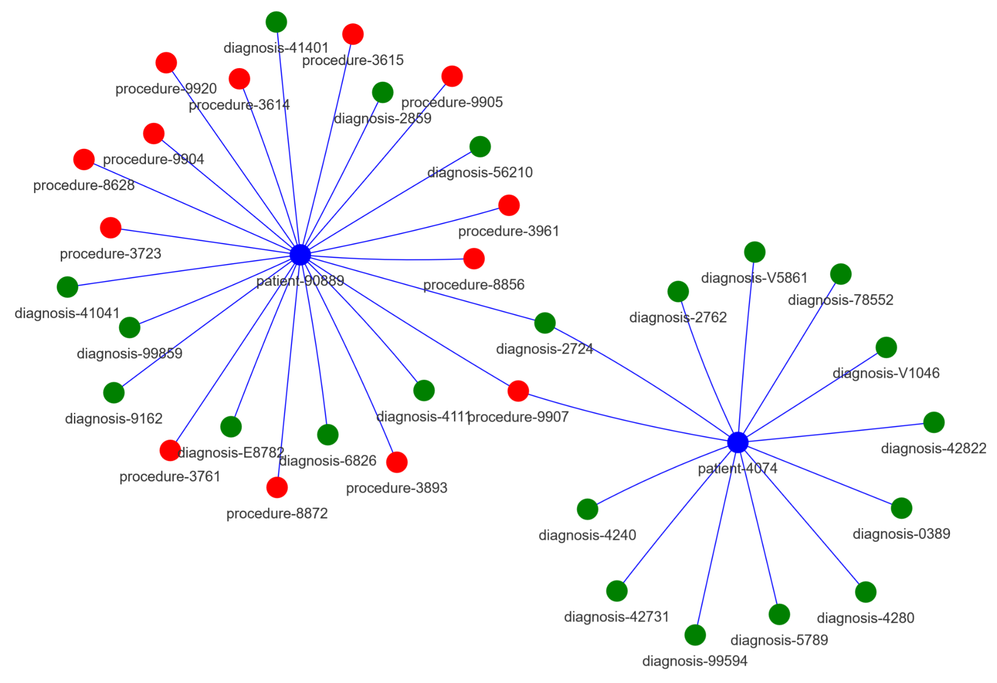
Graph Creation
Heterogeneous Graph constructed using NetworkX:
Nodes: Patients, Diagnoses (ICD-9 codes), Procedures
Edge Types:
Patient → has_diagnosis → Diagnosis
Patient → has_procedure → Procedure
Graph Size: 124K "has_diagnosis" edges, 49K "has_procedure" edges
Visualization: PyVis library used to ensure graph correctness
Graph composed of patient, diagnoses and procedure nodes

Slide 9
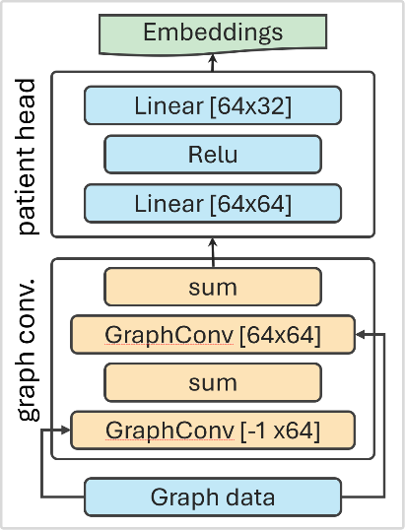
Relational Graph Convolutional Network
R-GCN Architecture:
Heterogeneous graph convolutional layers
Projection layer for patient nodes
Contrastive loss function
Contrastive Learning:
Pulls similar patients closer in embedding space
Pushes dissimilar patients apart
Loss function handles both cases
Training:
Adam optimizer (learning rate 0.005, weight decay 5e-4)
100 epochs on GPUs
Rapid convergence in first 20 epochs
Graph relationships (edges) are processed independently

Slide 10
Results
Model Convergence:
Loss decreased from 0.846 to 0.015 over 100 epochs
Successful learning of patient representations
Embeddings:
32-dimensional vectors capturing patient attributes and relationships
Can be used to identify similar patients through cosine similarity
Limitations:
Used only 25% of MIMIC-III data due to computational constraints
Similarity based only on diagnoses and procedures
No clinical validation by healthcare professionals

Slide 11
Future Directions
There are numerous opportunities for improving the system:
Additional development within the model to log accuracy and further tune the model which could not be addressed within the project timeline
Leveraging a graph database (such as Neo4j or Cloud Spanner) to persist the graph for continuous updates with new patient data
Creation of a RAG system that is frequently refreshed with a user interface for physicians
Addition of edges and nodes to mimic the complete structures present in MIMIC-III
Analysis and mining of physician notes for diagnosis, procedure and patient nodes.

Slide 12
Thank you!

Slide 13
Slide Presentation References
RBC Capital Markets. "The Healthcare Data Explosion." https://www.rbccm.com/en/gib/healthcare/episode/the_healthcare_data_explosion
Grand View Research. "Electronic Health Records Market Size & Share Report, 2030." https://www.grandviewresearch.com/industry-analysis/electronic-health-records-ehr-market
Brunswick Group. "Healthcare's Data Tsunami." https://www.brunswickgroup.com/healthcare-data-i20729/

